Slide 1


Forecasting Ontario's Energy Demand with
Climate and Population Data
Presented by Group 2
Briand Lancelot Rubin (1267280)
Wael Fahmy (1265745)
Junjun Hu (1264029)
May Khaing Latt (1276661)
Supervised by Prof. Dr. Mahzabeen Emu

Slide 2
Outline
Introduction
Problem Definition
Objective & Motivation
Data Description & Visualization
Methodology
Results & Demo
Implications and Applications
Conclusions and Future Works

Slide 3


Introduction
Have you ever thought about how Ontario’s weather might be impacting our energy demand?
Source: https://www.vectorstock.com/royalty-free-vector/four-seasons-weather

Slide 4

Problem Statement
Energy providers often struggle to balance supply and demand.
Without accurate forecasts, this leads to inefficiencies, higher costs, and wasted energy.
Source: https://medium.com/@cluelesscuriouscoders/energy-demand-forecasting-13e3f43dc4bb

Slide 5

So how do we solve this?
Source: https://deepstash.com/idea/397529/conclusion

Slide 6

Solution Overview
Predicting energy demand and price patterns to optimize energy management and support sustainable energy initiatives
Leverage Data Science and Machine Learning to implement this
Source: https://cleanearth4kids.org/renewable-energy

Slide 7
Positional Map
Ontario Specific
Studies Conducted
Predicting Smart Grid Stability with Deep Learning
Power Grid Stability with Deep Learning
Time Series forecasting with Prophet
Ontario Energy Demand Forecast with Time Series
Electricity Demand | ARIMA SARIMA Forecast
4
Opportunity
Fewer Relevant Features
5
More Relevant Features
2
3
1
Pan-Geographic

Slide 8



Objectives
Data-driven Model
Forecast Demand and Price
Energy Factors
Enhance Resource Planning
Minimize Cost
Ontario
Dataset
‹#›

Slide 9



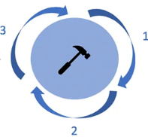

Methodology
DATA COLLECTION
|
|
|
|
|
|
|
|
DATA PREPROCESSING
|
|
|
|
|
|
|
|
DATA ANALYSIS
|
|
|
|
|
|
|
|
MODEL DEVELOPMENT & EVALUATION
3 sources
Demand, weather, population
Web scraping
Imputation by forward/backward fill
Alignment of time stamps
Consolidate weather data from different stations
Data Visualization
Identification of general trends, patterns
Feature Engineering
Network Modification
Loss and Prediction Analyses

Slide 10
Data Collection
Ontario Energy Demand Dataset
Source: Kaggle
Data availability: 2003-May ~ 2023-April
Interval: hourly
Ontario Weather Dataset
Source: AESO reports
Data availability: 2003 ~ 2023
Interval: hourly
Ontario Population Dataset
Source: Census Canada
Data availability: 2003 ~ 2023
Interval: quarterly

Slide 11



Data Collection
Ontario Energy Demand Dataset
Government of Canada - Ontario Weather
Statistics Canada
Ontario Population
Web Scraping Selenium (Browser Automation)
Download CSV File
Web Scraping
1
2
3
+

Slide 12
Data Preprocessing
Ontario Energy Demand Dataset
Ontario Weather
Ontario Population
Check for NaN values
Use sample-and-hold if found
Drop unwanted/duplicate columns (e.g., hour, time)
Forward/Backward fill for data like humidity, pressure
Use circular mean for wind direction
Create unified date/time column for easier dataset merging
Get average of 10 Ontario weather stations
Check for NaN values
Use linear interpolation if found

Slide 13
Dataset Challenges
No ready-made dataset , must build our own
Complex web structure - scraping and automation needed
Weather data from 10 Ontario stations - needs consolidation
Too many missing values - imputation techniques needed
Merge 3 datasets - create common key
Thousands of CSVs - heavy preprocessing
Notes:
No ready-made dataset is available, so we have to build one.
Ontario weather data is hard to collect due to messy web pages — web scraping and automation are needed.
Weather data comes from 10 different stations and must be averaged.
Many rows have missing values that need filling.
The three datasets must be merged using a new common key.
Thousands of CSVs need to be scraped, collected, and cleaned.
Different types of missing data require different imputation methods.

Slide 14
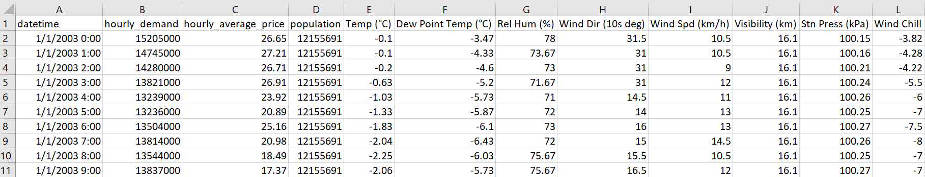
Data Description
Hourly Demand (Megawatt)
Hourly Average Price (CAD/MwH)
Population
Temperature / Wind Chill °C
Humidity %
Wind Speed (km/h)
177,554 rows

Slide 15
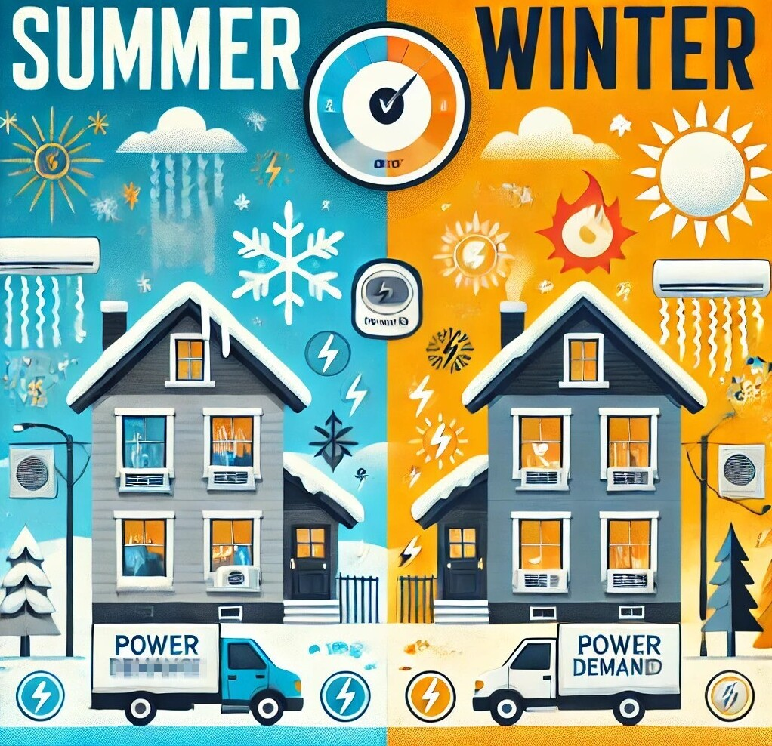
Bonus Question
Which energy demand is higher: summer or winter and why?
Source: AI Generated

Slide 16
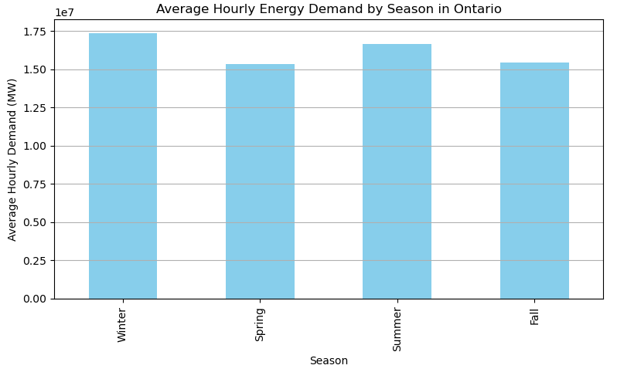
Answer: Winter

Slide 17
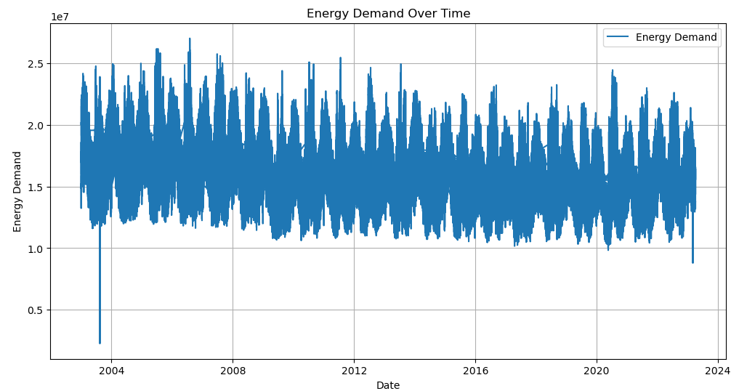
Data Visualization

Slide 18
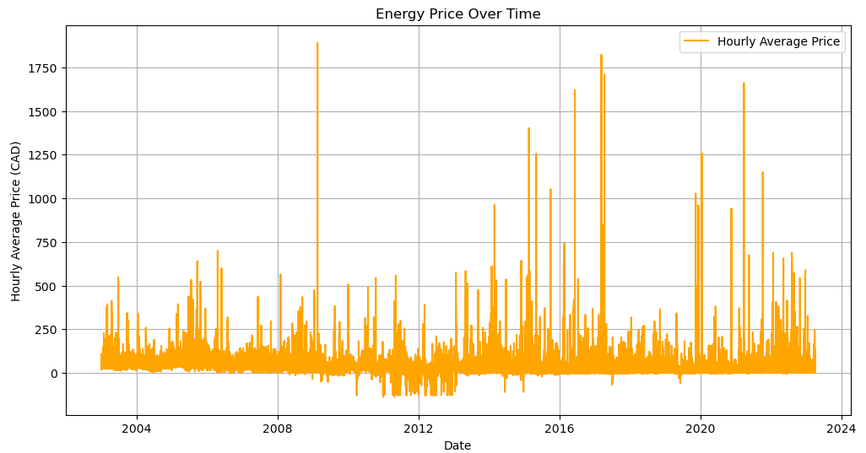
Data Visualization

Slide 19
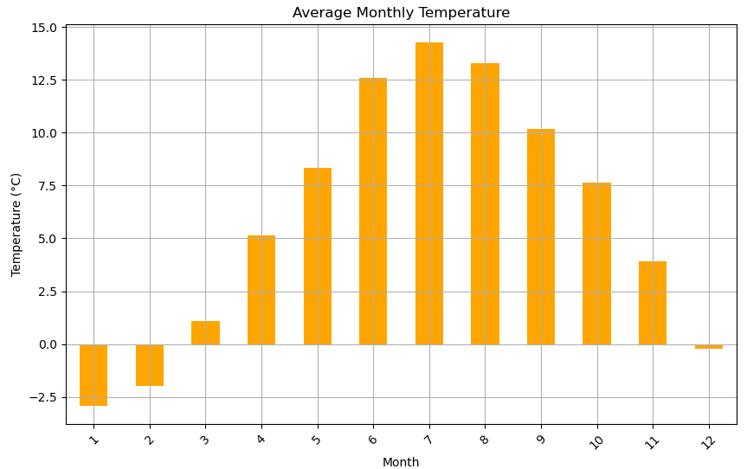
Data Visualization

Slide 20
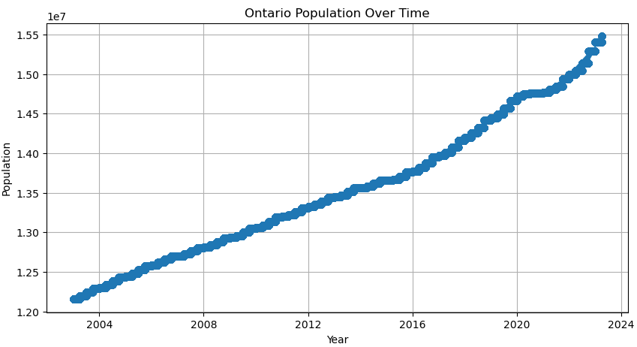
Data Visualization

Slide 21
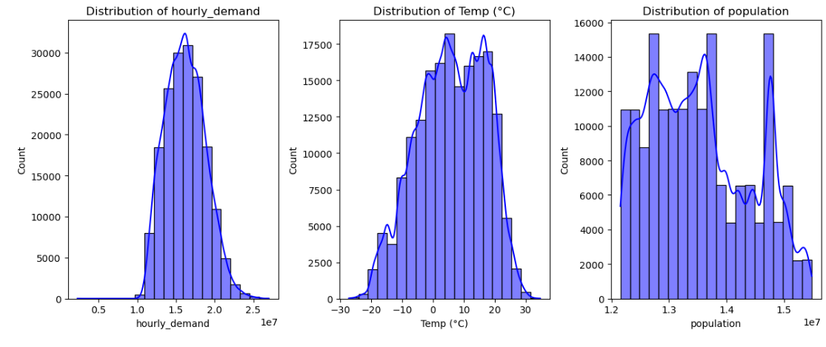
Data Visualization

Slide 22
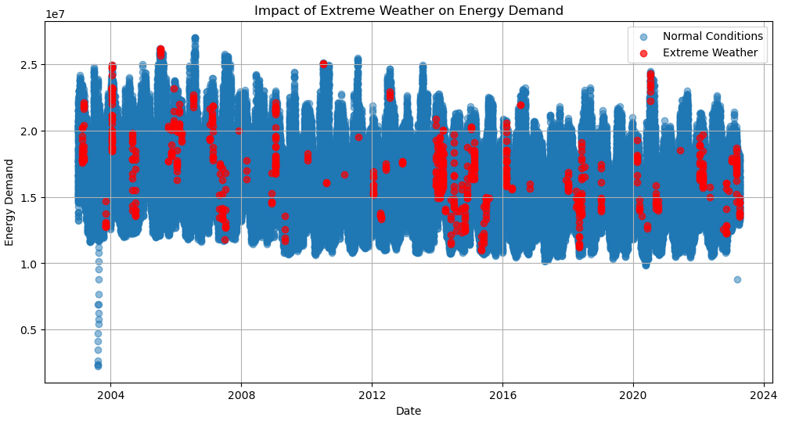
Data Visualization

Slide 23
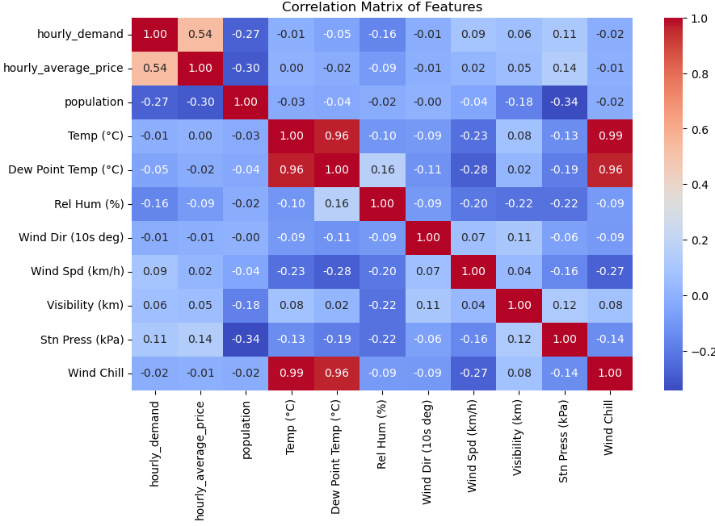
Feature Correlation

Slide 24
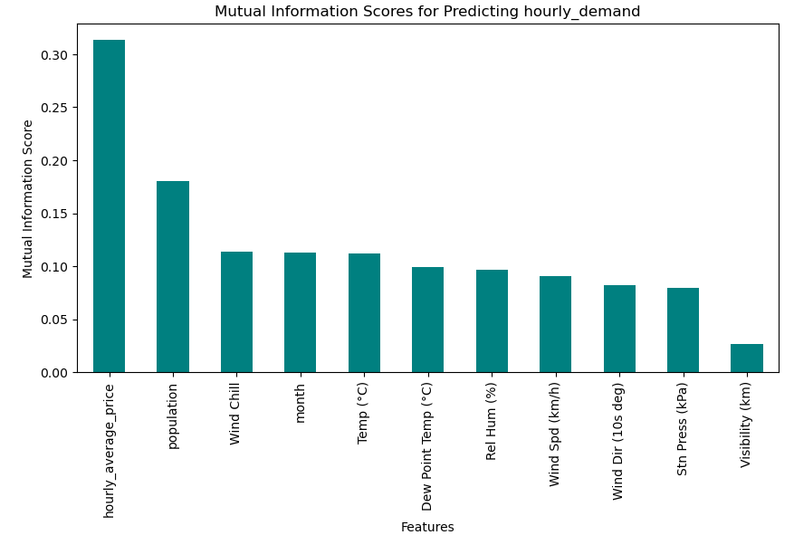
Feature Engineering
Price
Population
Wind Chill
Temp
Dates
Lags (1,2,3)

Slide 25
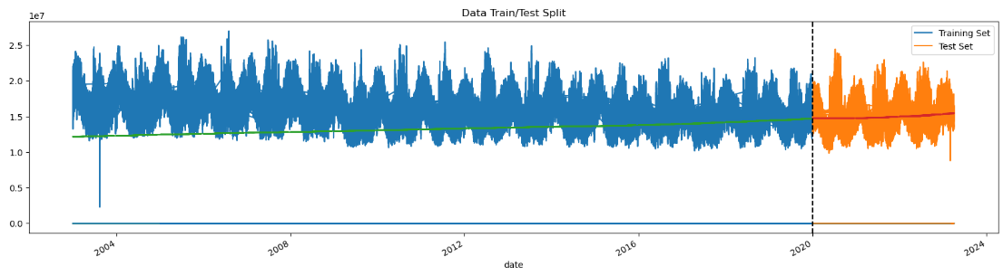
Data Split for XGBoost

Slide 26
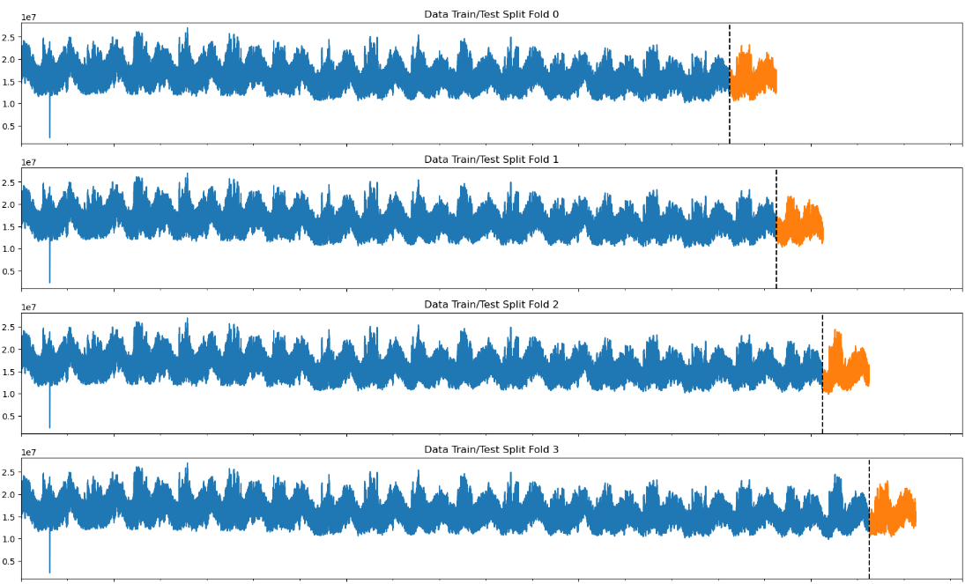
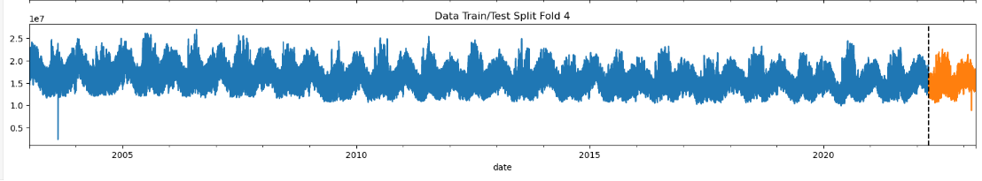
5-Folds Split

Slide 27
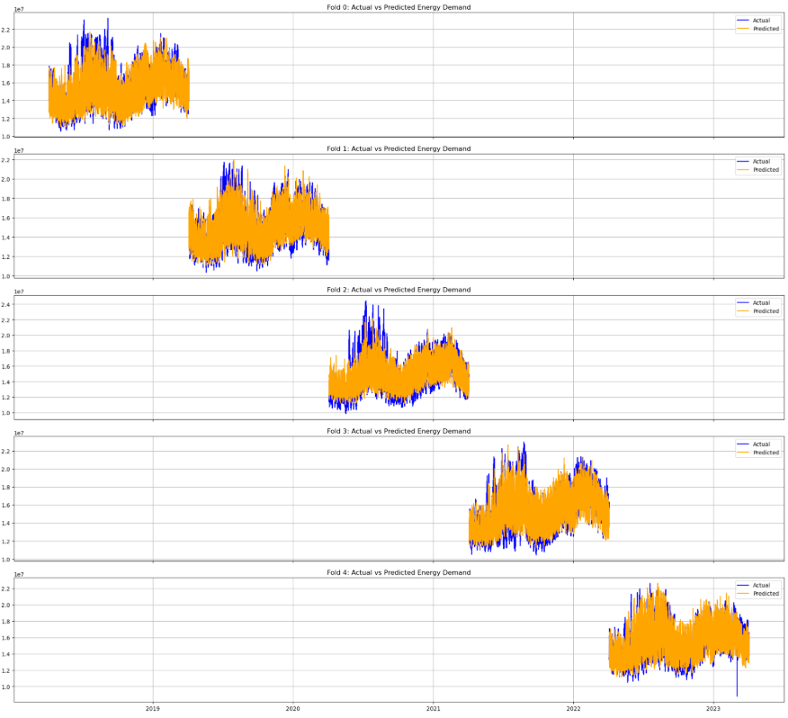
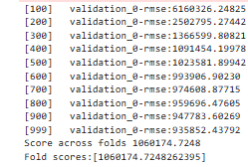
5-Folds Results

Slide 28
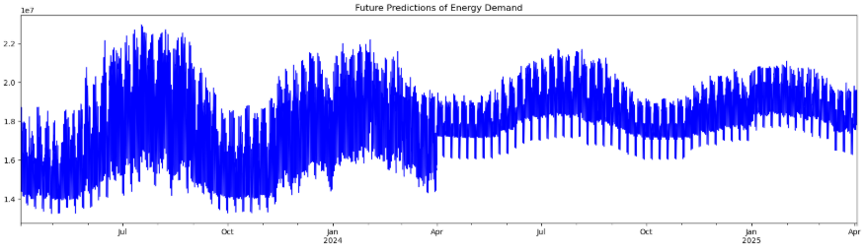
Future Prediction

Slide 29
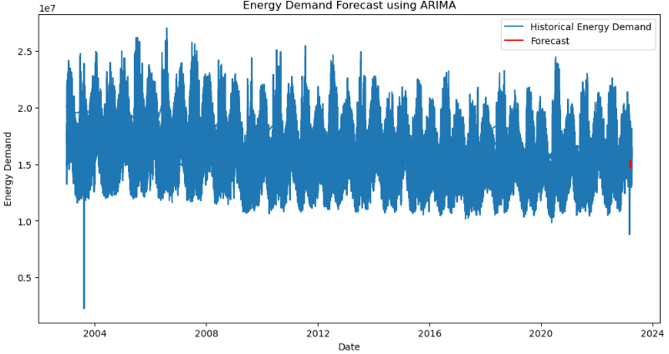
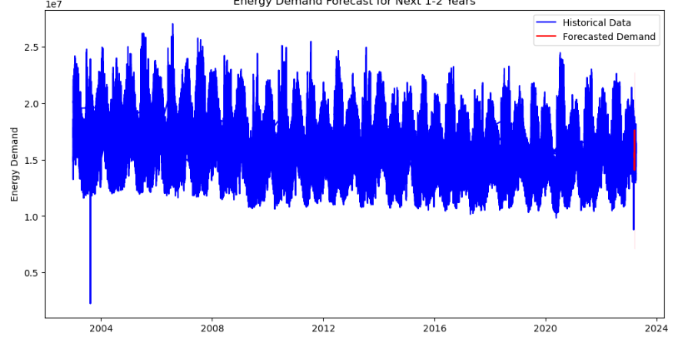
Why Not ARIMA or SARIMA?
ARIMA 30h
SARIMA 30h

Slide 30

Models Comparison
Time Series Models: ARIMA, SARIMA
Machine Learning: Random Forest, XGBoost, Light GBM.
Evaluation Metrics: Confusion Matrix RMSE, MAE for accuracy assessment.
Notes:
Let’s take a look at this slide titled 'Models Comparison,' which outlines the framework for evaluating different predictive models in our study.The slide is divided into three key points. First, we have the Time Series Models, which include ARIMA and SARIMA.Second, we list the Machine Learning models: Random Forest, XGBoost, and LightGBM. These are advanced ensemble methods known for their ability to capture complex patterns in data,Finally, the slide highlights the Evaluation Metrics we use to assess these models.

Slide 31
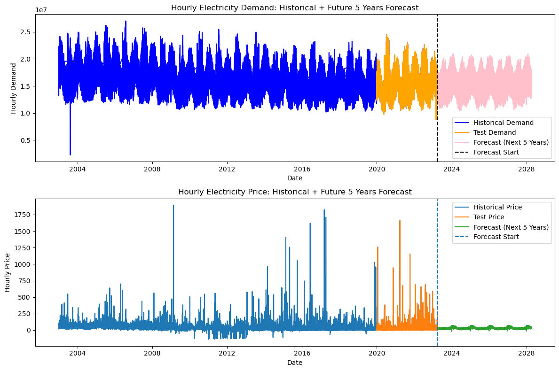
ML Models-XGboost
Notes:
The top plot shows Random Forest’s demand forecast in red, capturing the cyclical pattern of historical demand, which ranges from 0.5 to 2.5 units. The bottom plot shows the price forecast in green, smoothing out historical spikes up to 1750 units, indicating difficulty with price volatility.

Slide 32
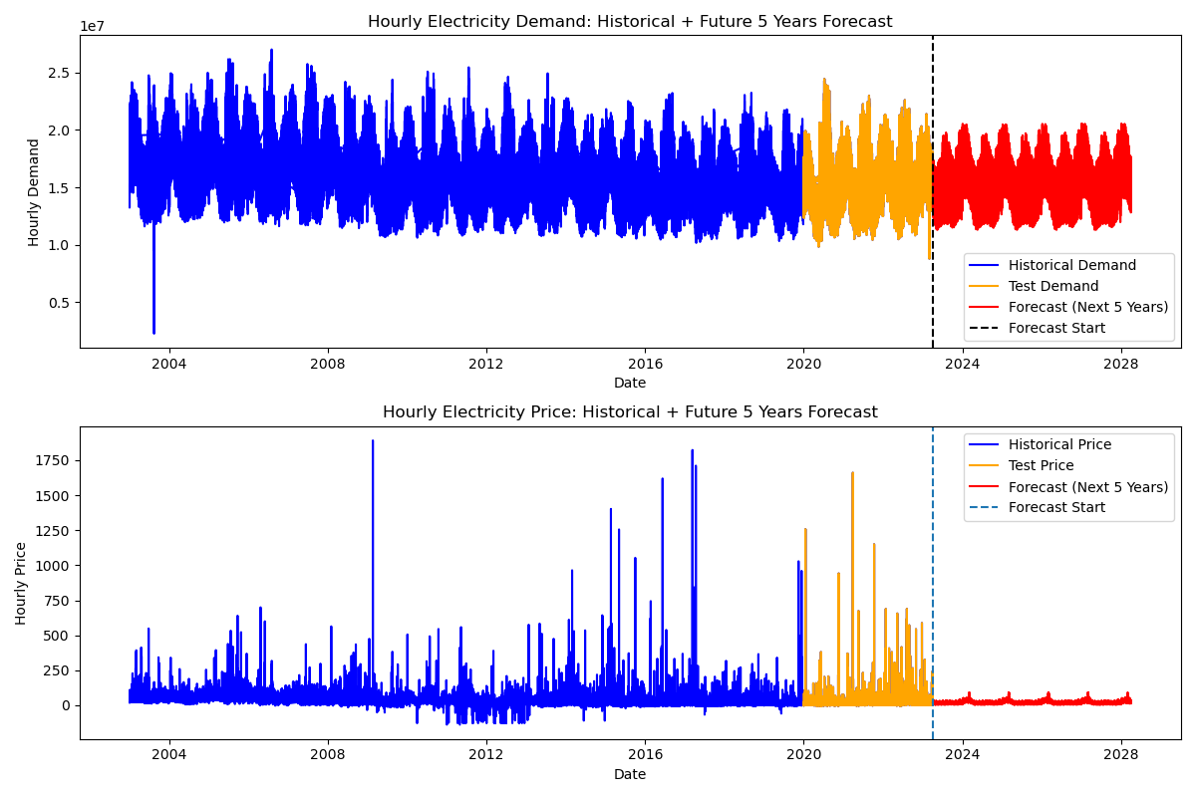
ML Models-lightGBM
Notes:
For LightGBM, the top plot’s demand forecast in red aligns well with historical cycles, similar to Random Forest. The bottom plot’s price forecast, also in red, smooths out spikes, underestimating price volatility like the previous model.

Slide 33
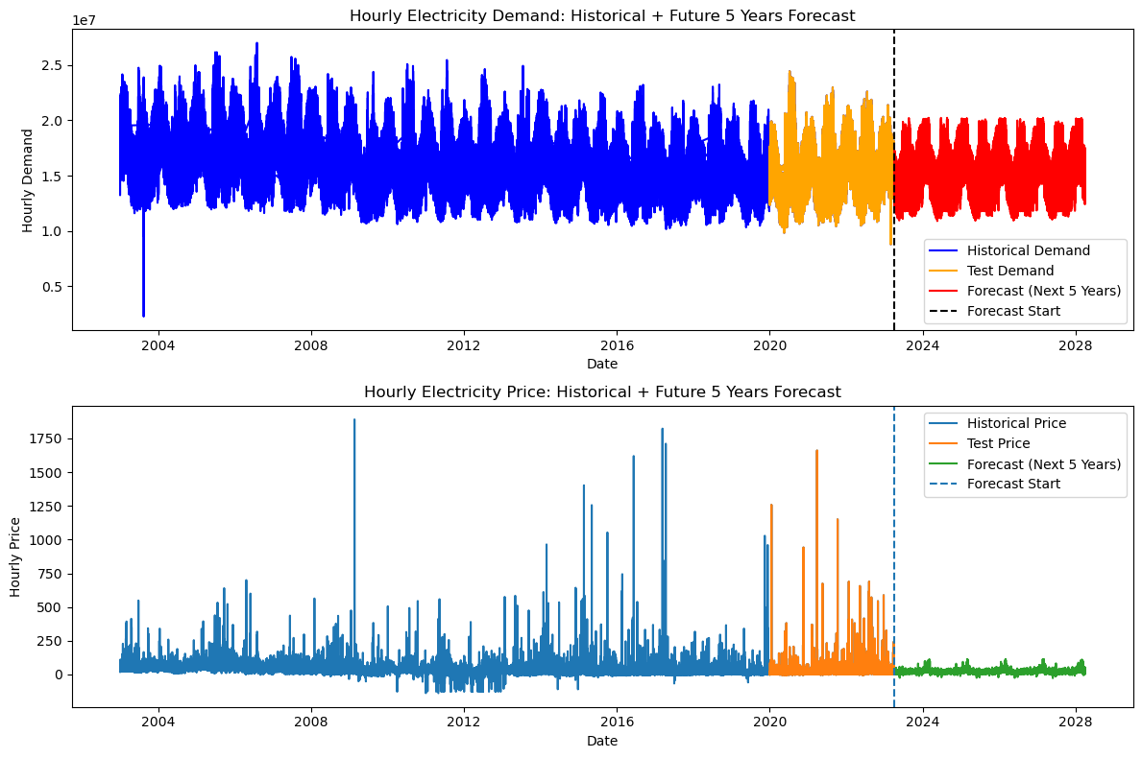
ML Models-Random Forest
Notes:
Finally, XGBoost’s top plot shows a strong demand forecast in pink, matching historical trends. The bottom plot’s price forecast in green smooths spikes but is slightly more responsive to trends than the other models.

Slide 34
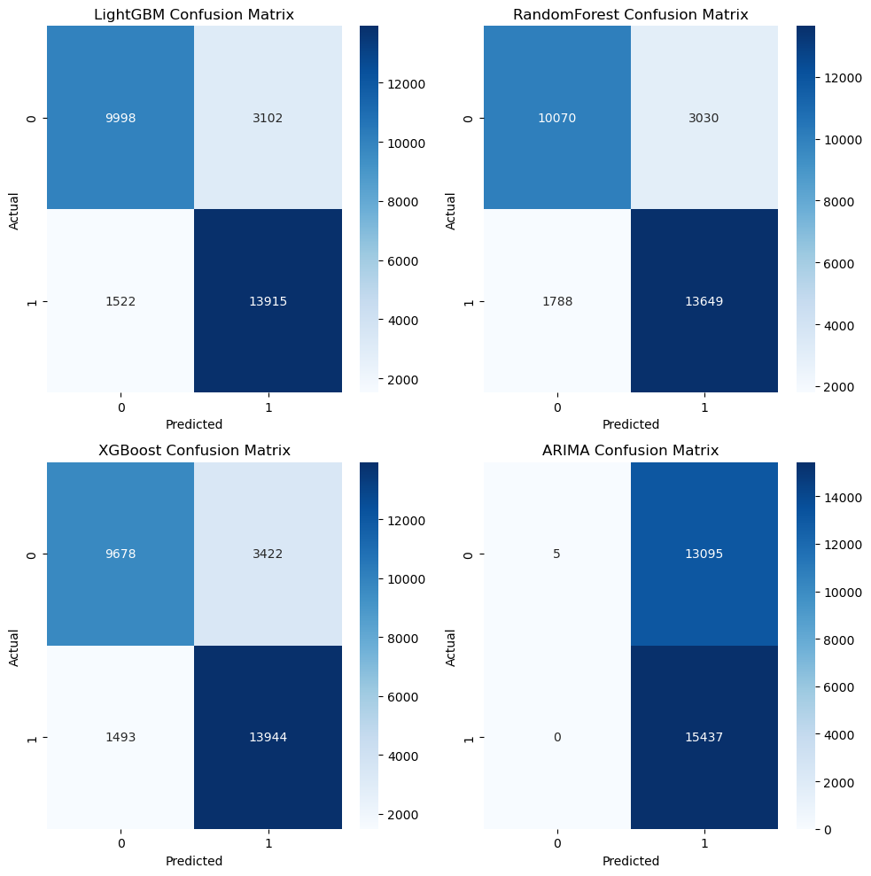
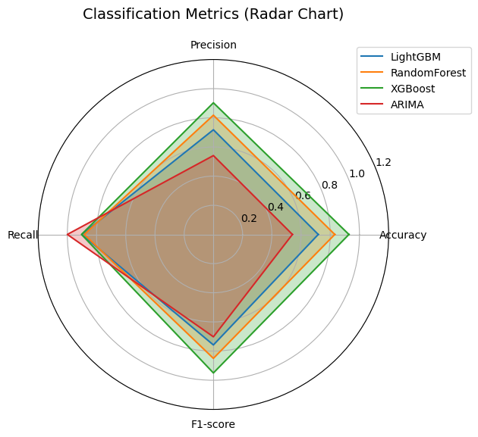
Results and Evaluation
Notes:
Let's take a look at Figure X, which presents the results and evaluation of four classification models: LightGBM, Random Forest, XGBoost, and ARIMA. The figure is divided into two main parts: a radar chart on the left and four confusion matrices on the right.
The radar chart, labeled 'Classification Metrics,' compares the performance of the four models across four key metrics: Precision, Recall, F1-Score, and Accuracy. Each model is represented by a different colored line—LightGBM in blue, Random Forest in orange, XGBoost in green, and ARIMA in red. The values range from 0 to 1From the chart, we can observe that LightGBM and Random Forest generally outperform XGBoost and ARIMA across most metrics, with LightGBM showing particularly strong results in Precision and F1-Score.
On the right side, we have the confusion matrices for each model, which provide a detailed breakdown of their classification performance. Each matrix shows the number of true positives, true negatives, false positives, and false negatives.Comparing the matrices, LightGBM and Random Forest again show better overall performance with higher true positive and true negative counts

Slide 35
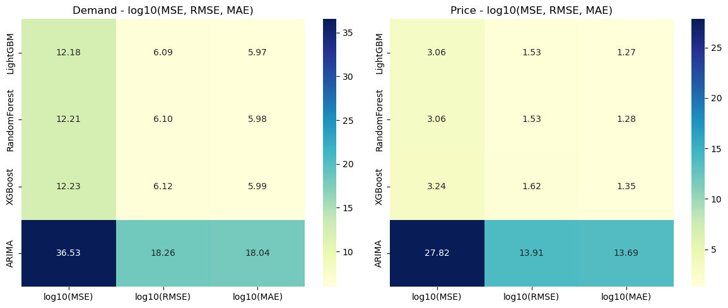
Results and Evaluation
Notes:
This slide compares LightGBM, Random Forest, XGBoost, and ARIMA on demand and price forecasting. The left heatmap shows demand metrics: LightGBM is best, ARIMA worst. The right heatmap shows price metrics: LightGBM leads again, ARIMA lags. LightGBM outperforms all.

Slide 36

Demo
Scan to View App (10 seconds to scan)
Notes:
Here's a concise, clear, 30-second English introduction for presenting to users on how to use the website:
"This website is an Ontario Energy Forecasting System built using Streamlit. To navigate, simply click the menu buttons at the top to access different sections: Home for an overview, Visualization to explore interactive charts, Prediction to select models and forecast electricity demand or prices, and Evaluation to review model performance. Select your preferred options from the dropdown menus, click the 'Run Prediction' button, and results will appear clearly on the screen. It's intuitive, straightforward, and designed to make energy forecasting easy."

Slide 37
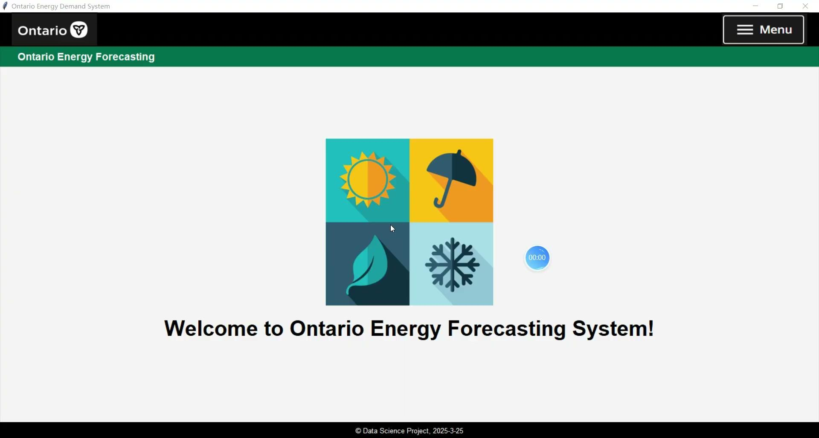
Demo Video

Slide 38

Demo Video
Notes:
Here's a concise 30-second English introduction for presenting your GUI to the audience clearly:
"This desktop application, built using Python's Tkinter library, provides an intuitive interface for forecasting Ontario's energy demand. To navigate, simply click the menu button at the top right, then select from Home, Visualization, Prediction, or Evaluation. In Visualization, you can explore detailed charts; in Prediction, choose models and targets to forecast future energy trends; and in Evaluation, view clear results assessing each model's performance. The design is user-friendly, interactive, and makes energy forecasting straightforward."

Slide 39

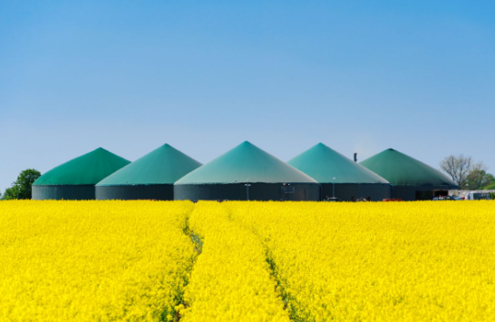
Implication
Improved accuracy in forecasting Ontario’s energy demand and price patterns Enables better anticipation of peak demand, price fluctuations, and system load, aiding in timely and data-driven decisions.
Supports energy resource optimization, reducing costs and enhancing efficiency Facilitates efficient allocation of generation resources, minimizes reliance on costly peaking plants, and lowers operational expenses.
Source: https://www.vectorstock.com/royalty-free-vector/increased-energy-demand-concept-icon-vector-37455139
Contributes to sustainable energy management and better infrastructure planning Informs long-term investments in grid modernization, renewable integration, and demand-side management initiatives.
Source: https://www.cer-rec.gc.ca/en/data-analysis/canada-energy-future/2023/results/

Slide 40
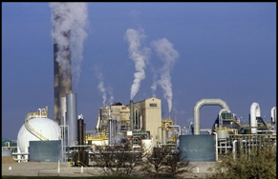
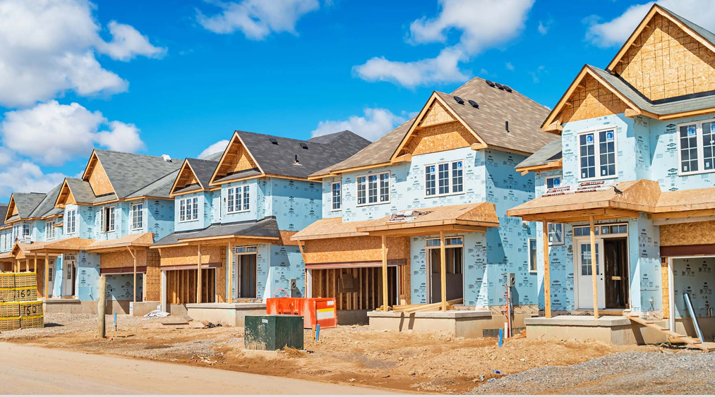
Potential Applications
Real-time operational support for utility providers.
Deliver monitoring and forecasting tools that integrate with utility infrastructure.
Enable better load-balancing, peak-demand preparation, and rapid decision-making for grid operators.
Once enhanced with real-time data streams, this solution becomes a powerful tool for grid operators
: Source: https://ir.lib.uwo.ca/cgi/viewcontent.cgi?article=1038&context=pclc_rpb
Population-Driven Energy Planning
Use population growth forecasts to predict where electricity demand will rise, especially in rapidly growing regions
Guide planning for housing developments, transmission expansion, and infrastructure investment aligned with Ontario’s goal to build 1.5 million new homes by 2030.
Source: https://www.ontario.ca/files/2023-07/energy-powering-ontarios-growth-report-en-2023-07-07.pdf

Slide 41


Conclusion & Future Work
Key Takeaways
High predictive performance—model achieved high accuracy
Successful implementation of a reliable Ontario energy forecasting system
Positioned the model as a foundation for smarter energy operations and future optimization.
Built a comprehensive Ontario energy dataset combining demand, weather, and population data
Developed a web application and API for prediction and data visualization.
Future Enhancements
Expand the forecasting system geographically, to other provinces with similar data structures
Incorporate real-time data for up-to-the-minute accuracy. (from smart meters, sensors, etc.)
Carbon Emission Forecasting to extend the model to estimate CO₂ emissions associated with energy usage

Slide 42
Team Contribution
Briand: 25%
Dataset Collection (Web Scraping+Selenium), Data Preprocessing, Intro, Dataset Consolidation
Wael: 25%
Visualizations, Feature Engineering, ML Models (XGBoost), Forecasting Models (ARIMA, SARIMA)
Junjun: 25%
Demo App website, ML Models (RF, Light GBM),model training and evaluation, Deploy to streamlit
May: 25%
Data Analysis, Documentation, Implications and Applications, References, Presentation Preparation

Slide 43
References
Nosovartiom. Electric Power Consumption Forecasting. Kaggle. https://www.kaggle.com/code/nosovartiom/electric-power-consumption-forecasting
Nawaz, M. H. Energy Consumption Using ARIMA and SARIMA. Kaggle. https://www.kaggle.com/code/muhammadhamzanawaz/energy-consumption-using-arima-and-srimax/input
Afroz, P. Ontario Energy Demand Forecast with Time Series. Kaggle. https://www.kaggle.com/code/pythonafroz/ontario-energy-demand-forecast-with-time-series/input
Government of Canada. Historical Climate Data. Environment and Climate Change Canada. https://climate.weather.gc.ca/historical_data/search_historic_data_stations_e.html?searchType=stnProv&timeframe=1&lstProvince=ON&optLimit=yearRange&StartYear=2003&EndYear=2023&Year=2025&Month=2&Day=17&selRowPerPage=25
Statistics Canada. Table 17-10-0009-01 Population estimates, quarterly. https://www150.statcan.gc.ca/t1/tbl1/en/tv.action?pid=1710000901&cubeTimeFrame.startMonth=01&cubeTimeFrame.startYear=2003&cubeTimeFrame.endMonth=10&cubeTimeFrame.endYear=2023&referencePeriods=20030101%2C20231001

Slide 44


Q&A

